Slide 1
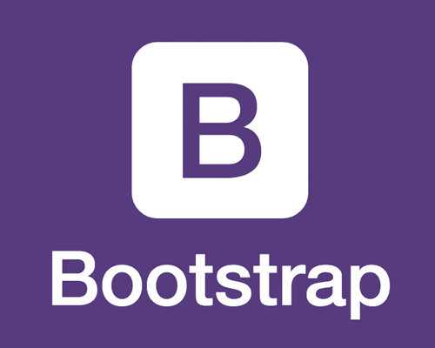
AND MOBILE INTERACTION DESIGN

Slide 2
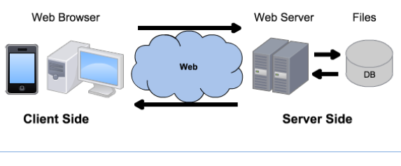
Linux
Windows
MacOS
Android
Linux
Windows Server
Apache
Tomcat
IIS
NodeJS
MySQL
Oracle
SQL Server
MongoDB
Chrome
Firefox
Safari
HTTP
HTTPS
HTML
CSS
JavaScript
PHP
Java
ASP
JavaScript
Bootstrap
SQL
JSON
jQuery
Notepad++
Eclipse
Visual Studio

Slide 3
Why Bootstrap?
Mobile devices now account for approx. 50% of web traffic worldwide.
The Challenges of Mobile Design:
Tiny screen sizes
Variable screen widths / heights
Touch screens
Difficulty of typing text
Challenging physical environments (moving, variable brightness)
Social influences and limited attention
Interaction design pattern books (2009, 2010)
Twitter Bootstrap - 2011
Notes:
https://www.statista.com/statistics/277125/share-of-website-traffic-coming-from-mobile-devices/

Slide 4
Mobile Design
For ease of use:
Optimize the most common interaction sequences
Eliminate or reduce typing
e.g. type = email on forms, a mobile browser will add ‘@’ ‘.com’ on main keyboard
hints and auto-complete (AJAX, browser cache…)
Reduce the number of taps
reduce the number of steps to complete tasks
For data usage optimization
Use as few page loads as possible (AJAX…)
Use lightweight protocols if possible (REST…)
For page load speed
Consider JS library choices (size, server side rendering…)
W3.CSS versus Bootstrap?
React versus Angular?

Slide 5
Mobile Users
What do mobile users actually need?
Users with a mobile device may only want to use your web app in particular ways
They won’t have the same range of needs that a user of the full website will have
Design for use contexts such as:
“I need to know something, quickly.”
“I need to do something, right now.”
“What’s relevant to the place I’m in at the moment?”
RIGHT HERE, RIGHT NOW

Slide 6
Web Apps versus Mobile Apps
Advantages of a mobile-first Web App
Immediacy – web apps are instantly available
Compatibility – web apps are compatible across devices
Upgradability – web apps can be updated instantly
Reachability – web apps can be found easily
(Former) Advantages of Mobile Apps
Can work offline (games, etc.) → Progressive Web Apps
Can use the camera, GPS, etc. → Browser HTML5 APIs navigator.geolocation.getCurrentPosition, navigator.mediaDevices.getUserMedia…
Can lead to a better user experience

Slide 7
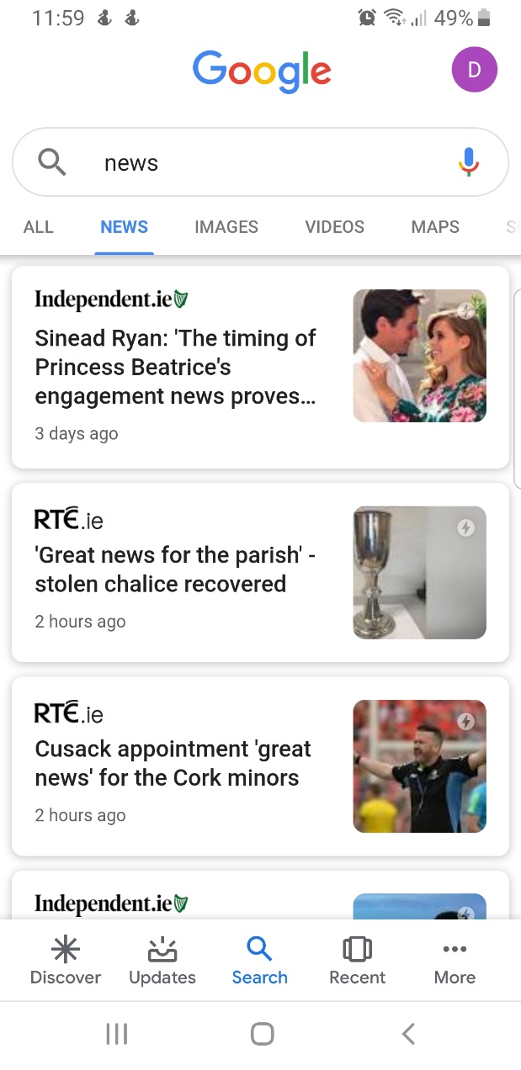
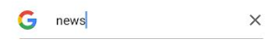
Mobile Interaction Design Patterns
Vertical stack
Generous borders
Thumbnail-and-text lists
Loading indicators
Filmstrip (swipe navigation)
Touch tools (show after touch)
Infinite list (append more)
Text clear button

Slide 8
Bootstrap
Bootstrap is the most popular HTML, CSS, and JavaScript library for developing responsive, mobile-first web sites.
Bootstrap is completely free to download and use, even in commercial applications.
Bootstrap creates responsive designs: apps that automatically adjust themselves to look good on all devices: phones, tablets and desktops.
Bootstrap is compatible with all modern browsers: Chrome, Firefox, Internet Explorer, Safari, and Opera
Notes:
CSS via Sass, a CSS pre-processor that lets you use features that do not exist in CSS, like variables, nested rules, imports, inheritance, built-in functions, etc. to reduce code repetition.

Slide 9
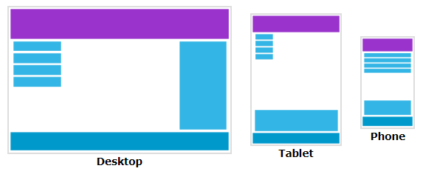
How?
The Browser Object Model (BOM) gives you:
The resolution of the screen, in pixels
screen.width
screen.height
The dimensions of the visitor's screen, in pixels, minus interface features like the Windows Taskbar
screen.availWidth
screen.availHeight
The width and height of the browser window's content area (viewport), including scrollbars, in pixels
window.innerWidth;
window.innerHeight;

Slide 10
Getting Bootstrap
There are two ways to start using Bootstrap:
Download Bootstrap from https://getbootstrap.com/
Include Bootstrap from a CDN
MaxCDN provides CDN support for Bootstrap's CSS and JavaScript.
You must also include jQuery from Google, for example.
Many users already have downloaded Bootstrap when visiting another site, so it will be loaded from cache in yours, which is faster.
Also, most CDNs will serve files from the server closest to the user, which is also faster.
<link rel="stylesheet" href="https://maxcdn.bootstrapcdn.com/bootstrap/4.2.1/css/bootstrap.min.css"> <script src="https://ajax.googleapis.com/ajax/libs/jquery/3.3.1/jquery.min.js"></script> <script src="https://maxcdn.bootstrapcdn.com/bootstrap/4.2.1/js/bootstrap.min.js"></script>

Slide 11
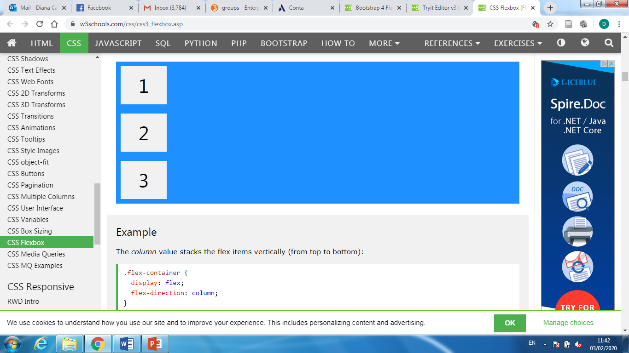
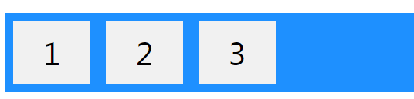
Bootstrap 3 or 4?
Bootstrap 4 is the newest version of Bootstrap; with new components, faster stylesheet and more responsiveness.
If you require IE8-9 support, use Bootstrap 3. It is the most stable version, and it is still supported by the team for critical bugfixes and documentation changes.
However, new features will NOT be added to it.
The biggest difference between Bootstrap 3 and 4 is that Bootstrap 4 now uses flexbox, instead of floats, to handle the layout.

Slide 12
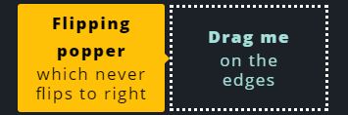
Bootstrap 4
Bootstrap 4 uses jQuery and Popper.js for JavaScript components (like modals, tooltips, popovers etc).
However, if you just use the CSS part of Bootstrap, you don't need them.
Popper.js is a positioning engine; its purpose is to calculate the position of an element to position it near a given reference element.
Popper.js is just ~6KB minified and gzipped, zero dependencies.
Its code base is in ES6 and tested against several browsers.
It integrates nicely with React, AngularJS and more!
<script src="https://cdnjs.cloudflare.com/ajax/libs/popper.js/1.14.6/umd/popper.min.js"></script>

Slide 13
Bootstrap First Page
<!DOCTYPE html> <!-- HTML5 --> <html lang="en"> <!-- language-->
<head>
<meta charset="utf-8"> <!-- character set --> <meta name="viewport" content="width=device-width, initial-scale=1">
<!-- mobile rendering and touch zooming --> <link rel="stylesheet" href="https://maxcdn.bootstrapcdn.com/bootstrap/4.2.1/css/bootstrap.min.css"> <script src="https://ajax.googleapis.com/ajax/libs/jquery/3.3.1/jquery.min.js"></script> <script src="https://cdnjs.cloudflare.com/ajax/libs/popper.js/1.14.6/umd/popper.min.js"></script> <script src="https://maxcdn.bootstrapcdn.com/bootstrap/4.2.1/js/bootstrap.min.js">
</script></head>
<body> <div class="container-fluid">
<!-- Bootstrap requires a containing element to wrap site contents. -->
<!-- The .container-fluid class provides a responsive full-width container -->
<!-- Containers are not nestable --> <h1>My First Bootstrap Page</h1> <p>This is some text.</p> </div> </body> </html>

Slide 14
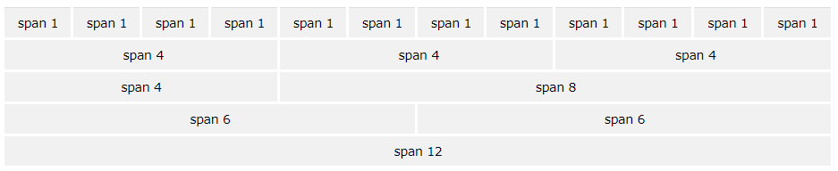
Bootstrap Grid System
Grid columns should add up to 12 for a row.
The columns will re-arrange automatically depending on the screen size
The Bootstrap 4 grid system has five classes:
Each class scales up, so if you wish to set the same widths for sm and md, you only need to specify sm.
.col- (extra small devices - screen width less than 576px)
.col-sm- (small devices - screen width equal to or greater than 576px)
.col-md- (medium devices - screen width equal to or greater than 768px)
.col-lg- (large devices - screen width equal to or greater than 992px)
.col-xl- (xlarge devices - screen width equal to or greater than 1200px)

Slide 15
Bootstrap Grid System
If you specify widths for a screen size, below that size the elements will stack
<div class="col-sm-6">
<div class="col-sm-6">
This will result in a 50/50 split on sm and above: md, lg and xl.
On extra small screens, it will automatically stack.
The classes can be combined to adjust the layout to better suit each screen size
<div class="col-sm-7 col-md-6 col-lg-8"> content </div> <div class="col-sm-5 col-md-6 col-lg-4"> content </div>
On small devices it will divide the content in two columns, one with 7/12 of the width, the other with 5/12
On medium devices, it’s a 50/50 split
On large devices it will be 2/3 vs 1/3 split

Slide 16
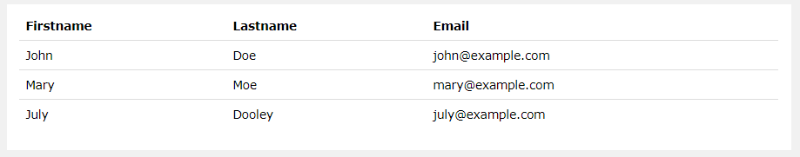
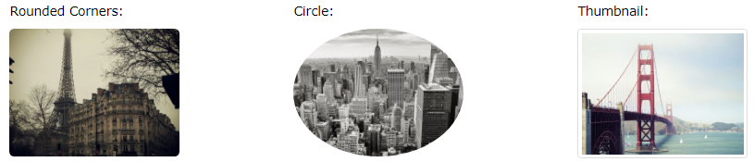
Bootstrap Styles
Tables have a light padding and only horizontal dividers.
The .table class adds basic styling to a table:
Images can have rounded corners (except on IE8)
.rounded
.rounded-circle
.img-thumbnail

Slide 17
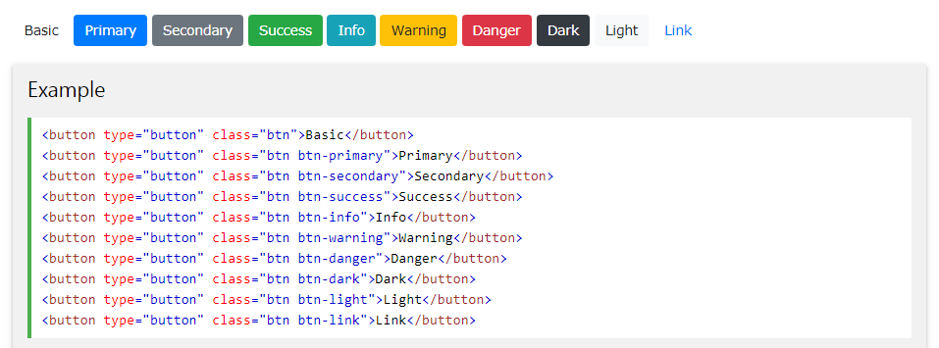
Bootstrap Styles
Buttons
These styles can be applied to <a>, <button>, <input type="button"> and <input type="submit">

Slide 18

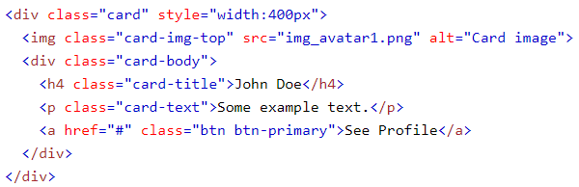
Bootstrap Styles
Cards
A card in Bootstrap 4 is a bordered box with some
padding around its content. It includes options for
headers, footers, content, images, overlays, etc.
If you are familiar with Bootstrap 3, cards replace
old panels, wells, and thumbnails.

Slide 19
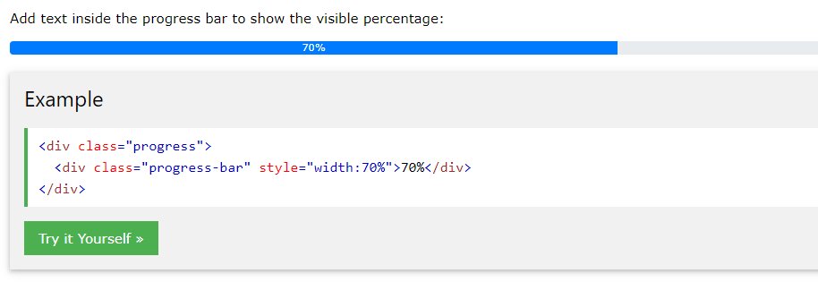
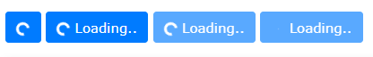

Bootstrap Styles
Loading indicators
Progress bars
Spinners
Spinners
<button class="btn btn-primary">
<span class="spinner-border spinner-border-sm"></span>
<div class="spinner-border"></div> Loading..
</button>

Slide 20
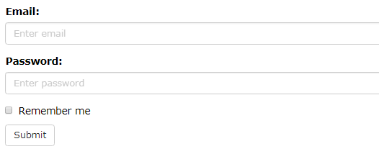
Bootstrap Styles
Forms
<form> <div class="form-group"> <label for="email">Email:</label> <input type="email" class="form-control" id="email"> </div> <div class="form-group"> <label for="pwd">Password:</label> <input type="password" class="form-control" id="pwd"> </div> <div class="checkbox"> <label><input type="checkbox"> Remember me</label> </div> <button type="submit" class="btn btn-default">Submit</button> </form>

Slide 21
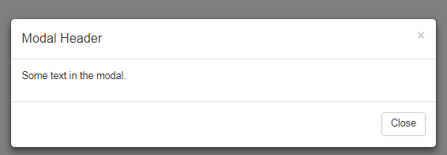
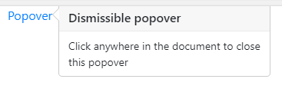
Bootstrap Components
Carousel (slideshow)
Modal (dialog/popup box)
Tooltip & Popover
Toast (temporary alert)
Scrollspy (automatically update links in a navigation list based on scroll position)
Fixed Navigation Bars

Slide 22
Bootstrap Templates
To be productive quickly, you can get pre-made free templates on:
https://getbootstrap.com/docs/4.4/examples/
https://www.w3schools.com/bootstrap4/bootstrap_templates.asp
→ Save the page source code and edit it.

Slide 23
Table Filtering Utilities
jQuery filter()
https://www.w3schools.com/bootstrap4/bootstrap_filters.asp
DataTables
https://www.datatables.net/
https://www.datatables.net/manual/styling/bootstrap4
Bootstrap Table
https://examples.bootstrap-table.com/

Slide 24
W3.CSS
W3.CSS uses only HTML and CSS to resize, hide, shrink, enlarge, or move the content to make it look good on any screen.
Lighter
Created by W3Schools
https://www.w3schools.com/w3css/default.asp
However, some features require JavaScript / jQuery:
Closable alerts, Carousel, Modals, Navbar (for collapsible menus), Tooltips and Popovers, Scrollspy…
Consider your requirements and resources when deciding what to use.

Slide 25
Questions?

